Slide 2
LAITEK
MIGRATEK
ATRIUM®
Proprietary & Confidential Information
Appendix

Slide 3
LAITEK Company Overview

Slide 4
Unparalleled Brain Trust
Founded in 1980
Romanian development subsidiary in 2002
London business office in 2012
20 years of DICOM migration experience
Active leaders in DICOM, HL-7, and IHE standards development
Multiple staff members have served as co-chairs, editors, and writers
Over 100 years combined DICOM expertise
Proprietary & Confidential Information

Slide 5
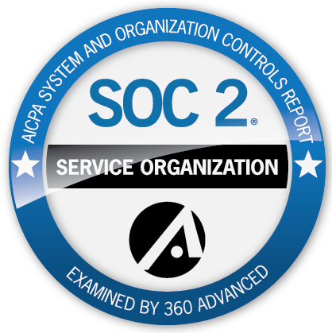
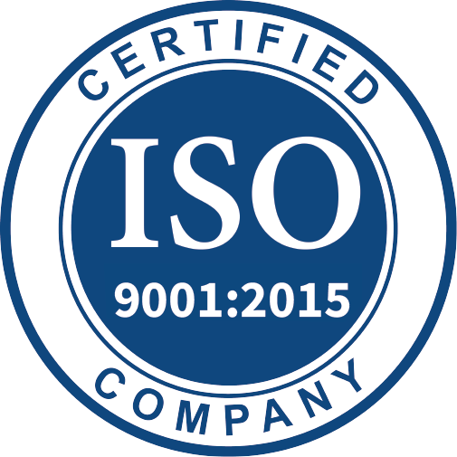
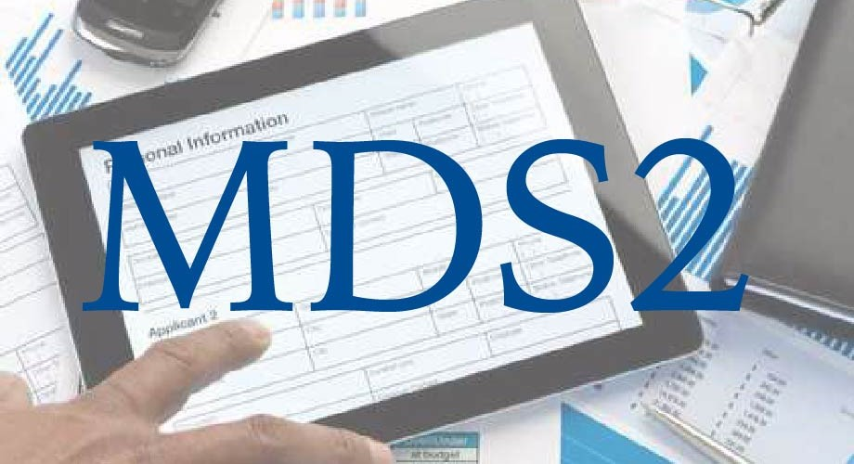
Standards & Conformance
FDA Registered Medical Device Establishment
ISO 9001:2015 Certification
SOC2 Type 2 Examination
IHE Integration Conformance
DICOM Conformance
Manufacturer Disclosure Statement for Medical Device Security (MDS2)
Proprietary & Confidential Information

Slide 6
The LAITEK Difference
PACS & VNA agnostic
Connectors to over 60 different systems
Access to all data, standard and proprietary
Unparalleled speeds with minimal clinical impact
Comprehensive data normalization to the DICOM standard
Reporting, final reconciliation and validation procedures
Advanced migration prefetch logic
Peerless experience with large, complex projects
Unmatched reputation for quality, security, and delivery
Proprietary & Confidential Information

Slide 7
MIGRATEK Data Migration Services
Advanced
Migration
Services
Essentials
Migration
Services
Custom
Engineering
Data
Recovery

Slide 8
MIGRATEK Advanced Migrations
CONVENTIONAL C-MOVE MIGRATIONS
LAITEK ADVANCED MIGRATIONS
Limited access to study data
Loss of clinical speed
Only basic study data collected
Slow migration speeds
≈ 0.5 TB / ≈ 12k studies per day
A 500TB project = 1,000 days to complete
Narrow scope of application
Deep-reaching study data access
Migrate all day without impact
All data captured — nothing left behind
Rapid migration speeds
≈ 6.25 TB / ≈ 150k studies per day
A 500TB project = 80 days to complete
Expansive project opportunities
Proprietary & Confidential Information
MIGRATEK

Slide 9
The LAITEK Method
Proprietary & Confidential Information
MIGRATEK

Slide 10
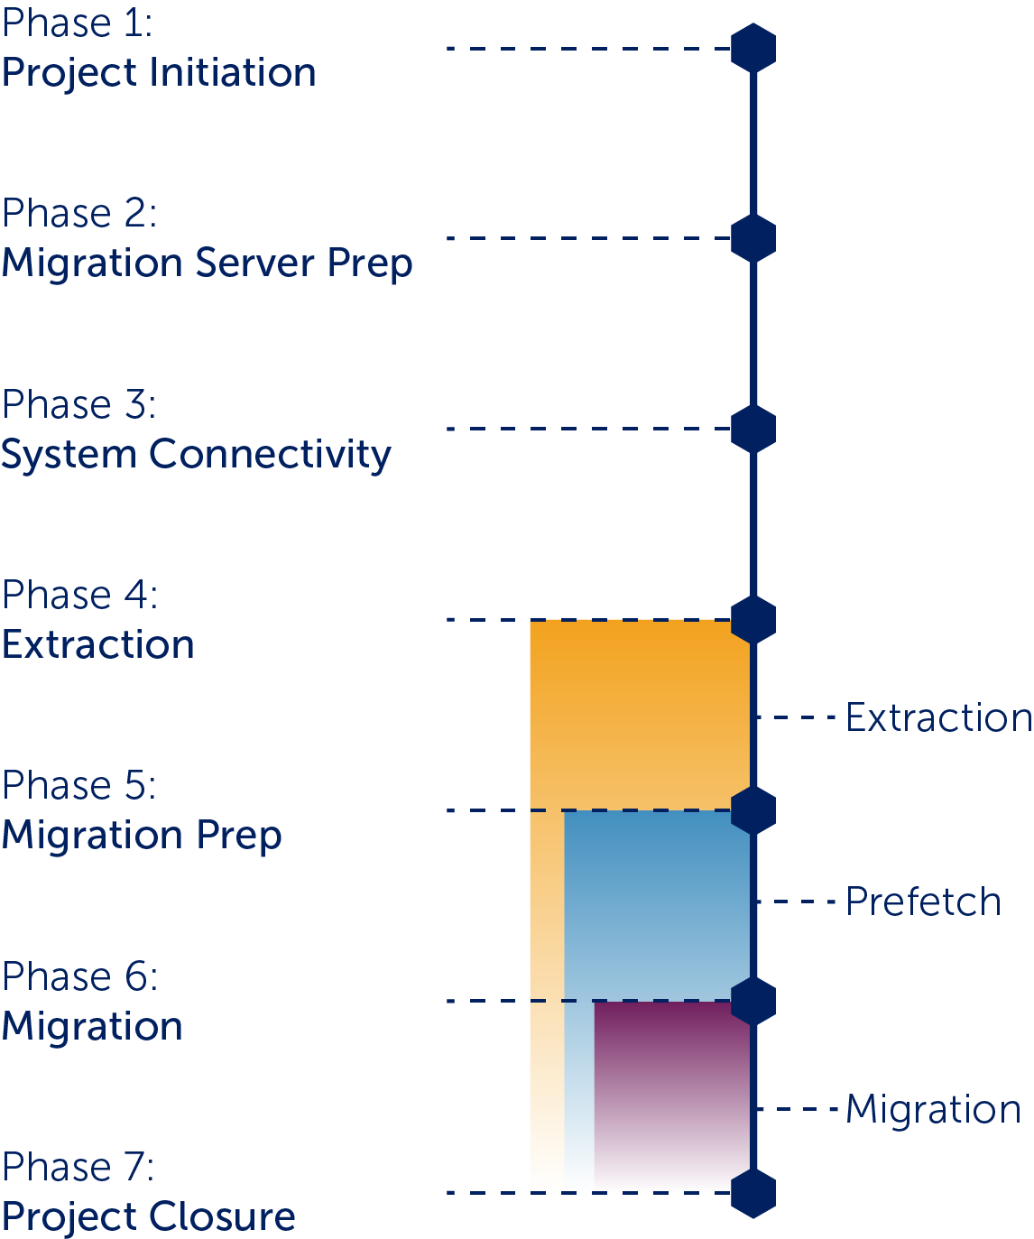
The LAITEK Method
Phase One — Project Initiation
Prepare project plan
Laitek internal project kick-off
Site kick-off with stakeholders
Server delivery and setup or VM setup and configuration
Setup VPN Connectivity
Phase Two — Migration Server Preparation
Prepare Server, Database and Code Updates
Monitoring and Antivirus Setup
Proprietary & Confidential Information
MIGRATEK

Slide 11
The LAITEK Method
Phase Three — System Connectivity
Configure Source and Target DICOM connectivity
Perform CFIND Inventory
Provide CFIND Assessment Report
Laitek Connector Configuration and validation
Configure migration prefetch
Proprietary & Confidential Information
MIGRATEK

Slide 12
The LAITEK Method
Phase Four — Extraction
Begin Extraction
Define Minimum Data Set Completion
Setup Daily Reports
Generate Accession Numbers as needed
Handling of Multimatches
Proprietary & Confidential Information
MIGRATEK

Slide 13
The LAITEK Method
Phase Five — Migration Preparation
Setup HL7 Receiver
ADT, Orders, Reports
Migrate Sample Set
Crosswalk Configuration
MRN, Procedure, Physician
Perform Integrated Testing
Client Approval of Integrated Samples
Proprietary & Confidential Information
MIGRATEK

Slide 14
The LAITEK Method
Phase Six — Migration
Start order migrations
Start study and report migration
Start migration prefetch
Prepare for Go-Live
Initiate clean-up
Proprietary & Confidential Information
MIGRATEK

Slide 15
The LAITEK Method
Phase Seven — Project Closure
Inbound/outbound cleanup
Final reconciliation on Legacy System
Generate Exception Notice Objects
Final settlement sheets
Client Acceptance and Project Closed
Exception Archive
Utilized for studies not able to migrate
Laitek solution or (ATRIUM® Keep)
Third party solution
Proprietary & Confidential Information
MIGRATEK

Slide 16
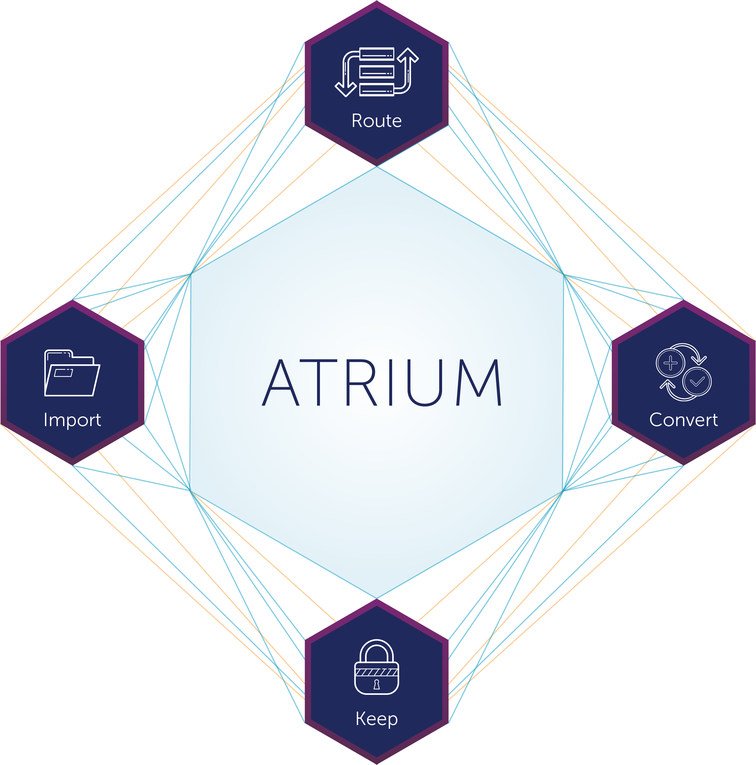
The LAITEK Method
System Health — After project closure
ATRIUM® Suite Solutions
Keep
Convert
Route
Import
Proprietary & Confidential Information
MIGRATEK

Slide 17
Essentials Migration Services
Ideal for DICOM “as-is” migration projects
Migrate without transformations or localizations
Limited data integration scope
Appropriate for smaller, less-complex projects
Still backed by LAITEK Standards & SOP
Regardless of size, Essentials carries the same level of care
Metadata mapping, migration prefetch, and storage validation
Proprietary & Confidential Information
MIGRATEK

Slide 18
Custom Engineering
Custom, unique data conversions
Regardless of the format, LAITEK can develop a solution to meet site needs
Specialized source & target connectors
Anything outside of our 60+ database and storage system connectors can be built
Deep, consultative approach
LAITEK works closely with client to ensure build matches need
100+ combined years of DICOM experience
Proprietary & Confidential Information
MIGRATEK

Slide 19
Data Recovery
Unreadable study & image data
PACS / VNA cannot read, view, or store
Discrepancy reconciliation
Corrupted files
Missing images
Ideal for sunsetting hardware, systems, etc.
Retain valuable studies, images, and files
No data left behind
Proprietary & Confidential Information
MIGRATEK

Slide 20
ATRIUM® Management Solutions
ATRIUM®
Suite
ATRIUM®
Route
ATRIUM®
Convert
ATRIUM®
Keep
ATRIUM®
Import

Slide 21
ATRIUM® Suite
Integrate virtually any system to operate smoothly and easily
Customized workflows that meet your needs, not work around them
Seamlessly manage how and where your data integrates
Implement automations that respond to and predict your site’s specific structures
Proprietary & Confidential Information
ATRIUM®

Slide 22
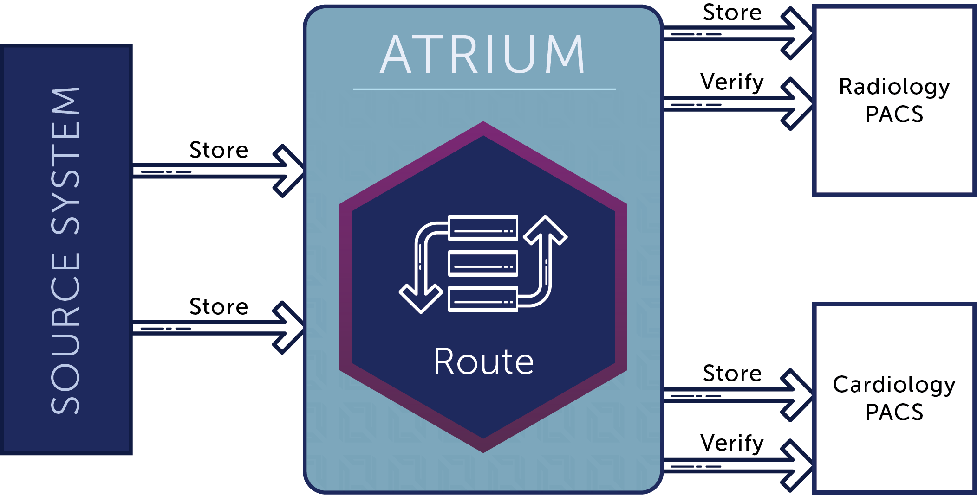
ATRIUM® — Route
Facilitate SR measurements into reports
Filter studies and transform data to improve integration
Robust storage verification ensures all objects are stored in targets
Hologic SCO to BTO available when combined with ATRIUM® Convert
Proprietary & Confidential Information
ATRIUM®

Slide 23
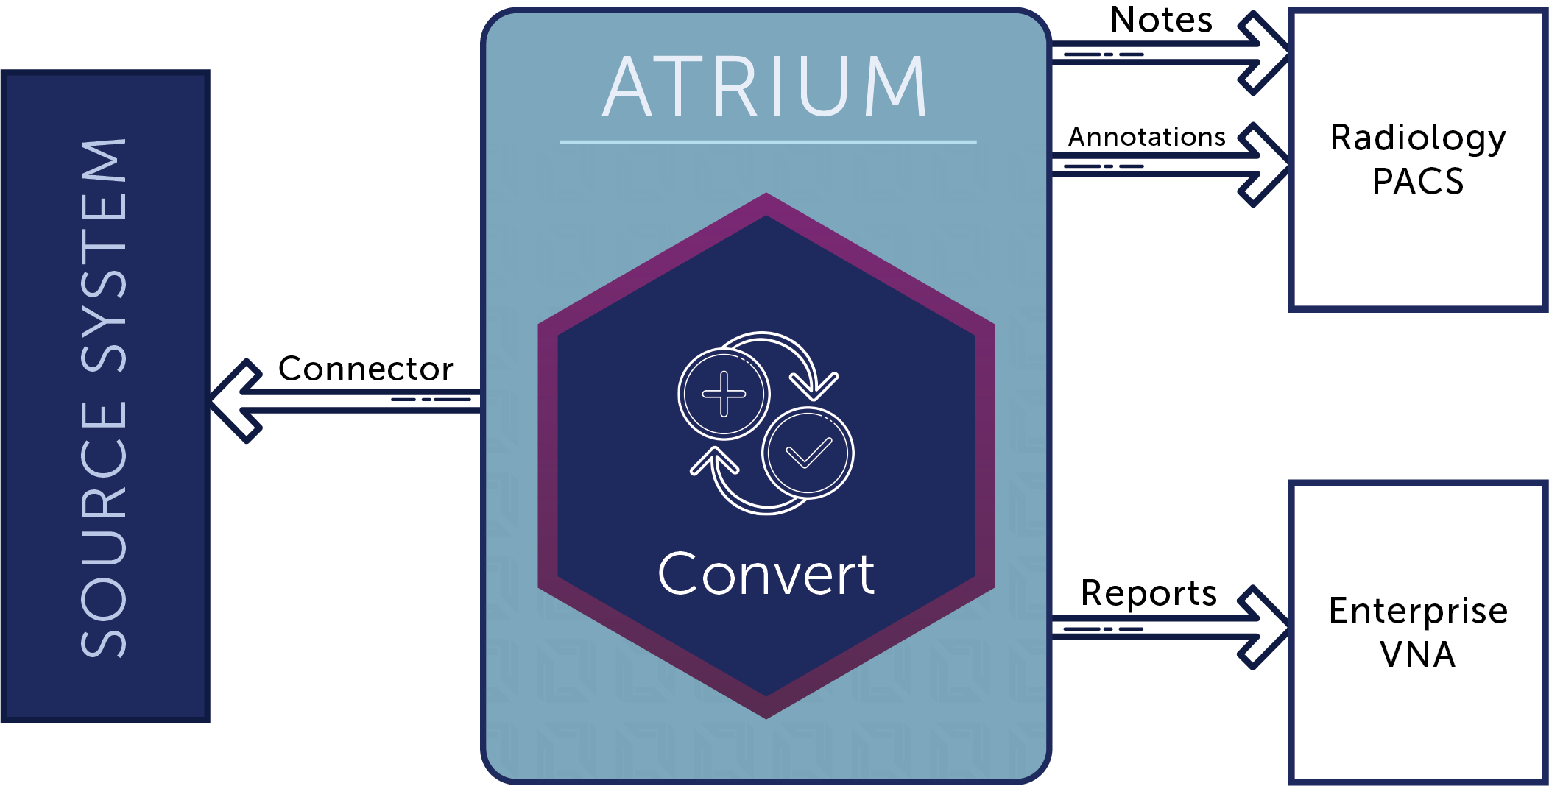
ATRIUM® — Convert
Seamlessly bypass the challenge of incompatible formatting
Custom conversions
Hologic SCO to BTO
Fetal Waveform to PDF
Tech notes
DICOM ECG to PDF
Many more
Proprietary & Confidential Information
ATRIUM®

Slide 24
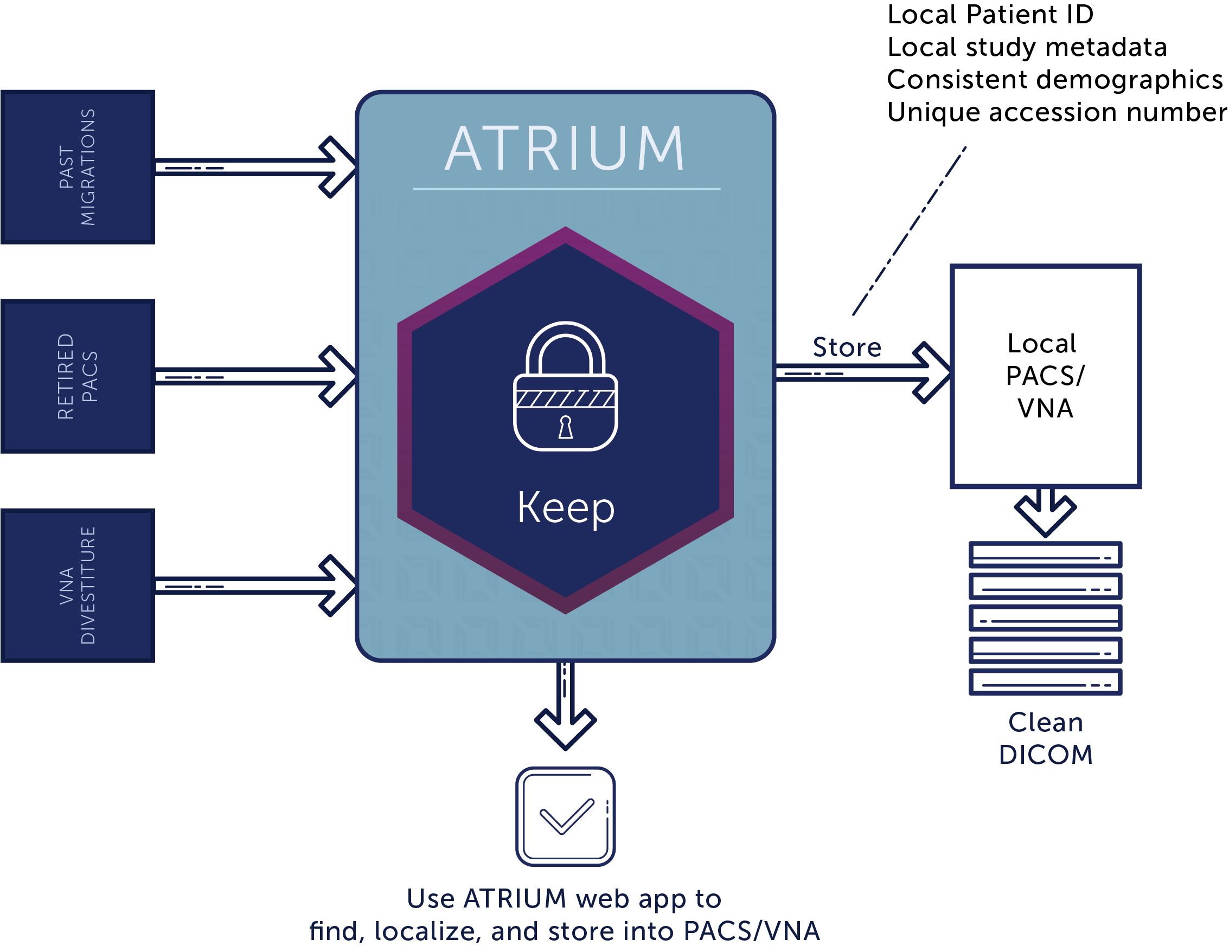
ATRIUM® — KEEP
Inexpensive alternative for legacy data storage
Keep unmigrated data out of PACS or VNA
Enable expedited closure of migration projects
Immediate retirement of a PACS without waiting for migration
Migrate studies as needed
Proprietary & Confidential Information
ATRIUM®

Slide 25
ATRIUM® — Import
Keeps foreign patient IDs and inconsistent demographics out of PACS
Select relevant images and toss the rest
DICOM-encapsulated PDF documents
Web app enables CD import from any station
Proprietary & Confidential Information
ATRIUM®

